Slide 1
Final Project Ideas
Calvin Cheang

Slide 2
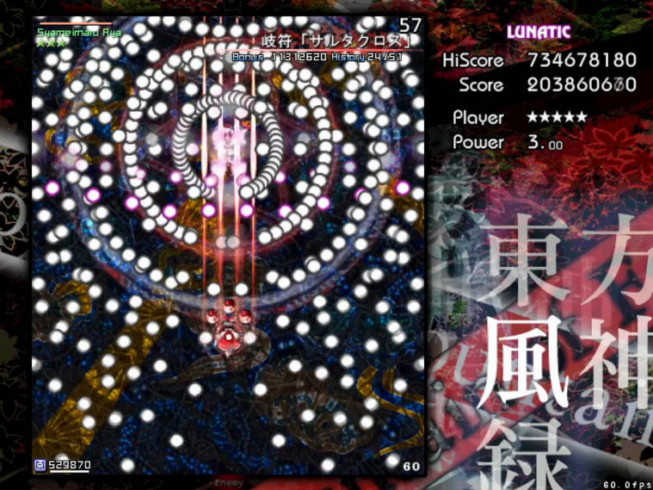
Idea 1: Bullet Hell
Shooter game that involves particle systems
Character will be controlled via user input
Will incorporate a score that increases with every hit
Might incorporate a lives system
Inspiration from other bullet hell games such as Touhou

Slide 3
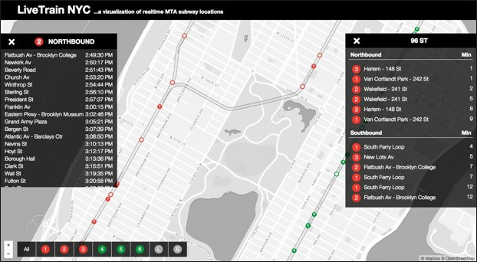
Idea 2: Subway Simulation
Receive information on arrival times from API
Translate it to a moving light along a route
Inspiration from real time subway maps

Slide 4
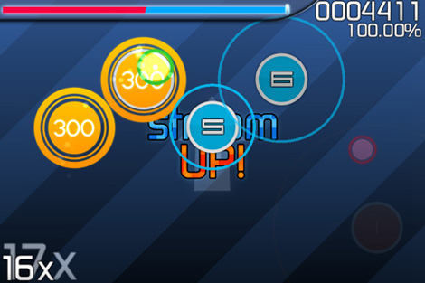
Idea 3: Rhythm Game
Inspiration from Osu and Cytus
Circles spawn in tune with the song
User must click before the outer ring hits the circle
Makes use of timing and user input as well as arrays for the beats
Will have audio track

